Slide 1
CS236
Discrete Structures

Slide 2
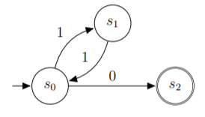
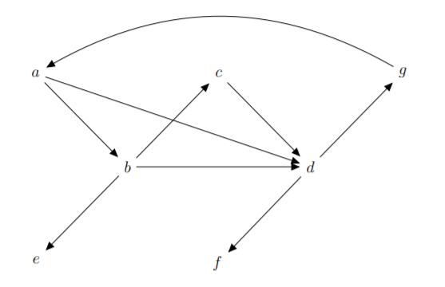
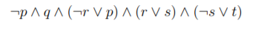
Course Goals – Math Concepts for CS
This is a “math-first” class
Applied to databases
Each project uses a different piece of math
Notes:
What is a schema: a representation of information and how it is used

Slide 3
Course Goals – Math Concepts for CS
Learn three key Schemas:
Machines and Languages
Logic and Relations
Graphs and Algorithms
Notes:
What is a schema: a representation of information and how it is used

Slide 4
[Math] is very hard. We sometimes conceal this fact from our students, with the idea that we are doing them a service. It's just the opposite ... When we say that the lesson at hand is easy or simple, and it manifestly isn't, we are telling the student that the difficulty isn't with the mathematics, it's with them ... Our students [become] afraid to ask questions in class because they are afraid of looking stupid. If we were honest about how difficult and deep mathematics is ... this would surely be less of a problem.
Chapter 9 of Shape: The Hidden Geometry of Information, Biology, Strategy, Democracy, and Everything Else, by Jordan Ellenbert

Slide 5
[Math] is very hard. We sometimes conceal this fact from our students, with the idea that we are doing them a service. It's just the opposite ... When we say that the lesson at hand is easy or simple, and it manifestly isn't, we are telling the student that the difficulty isn't with the mathematics, it's with them ... Our students [become] afraid to ask questions in class because they are afraid of looking stupid. If we were honest about how difficult and deep mathematics is ... this would surely be less of a problem.
Most students find that the hardest part of the class is matching up the math and the code
Chapter 9 of Shape: The Hidden Geometry of Information, Biology, Strategy, Democracy, and Everything Else, by Jordan Ellenbert

Slide 6
Assignments and Grades

Slide 7
Course Assignments
5 Projects – all connected; the final project is one large system
~26 HWs – due on Monday, Wednesday, or Friday
1 Midterm
1 Final Exam – cumulative

Slide 8
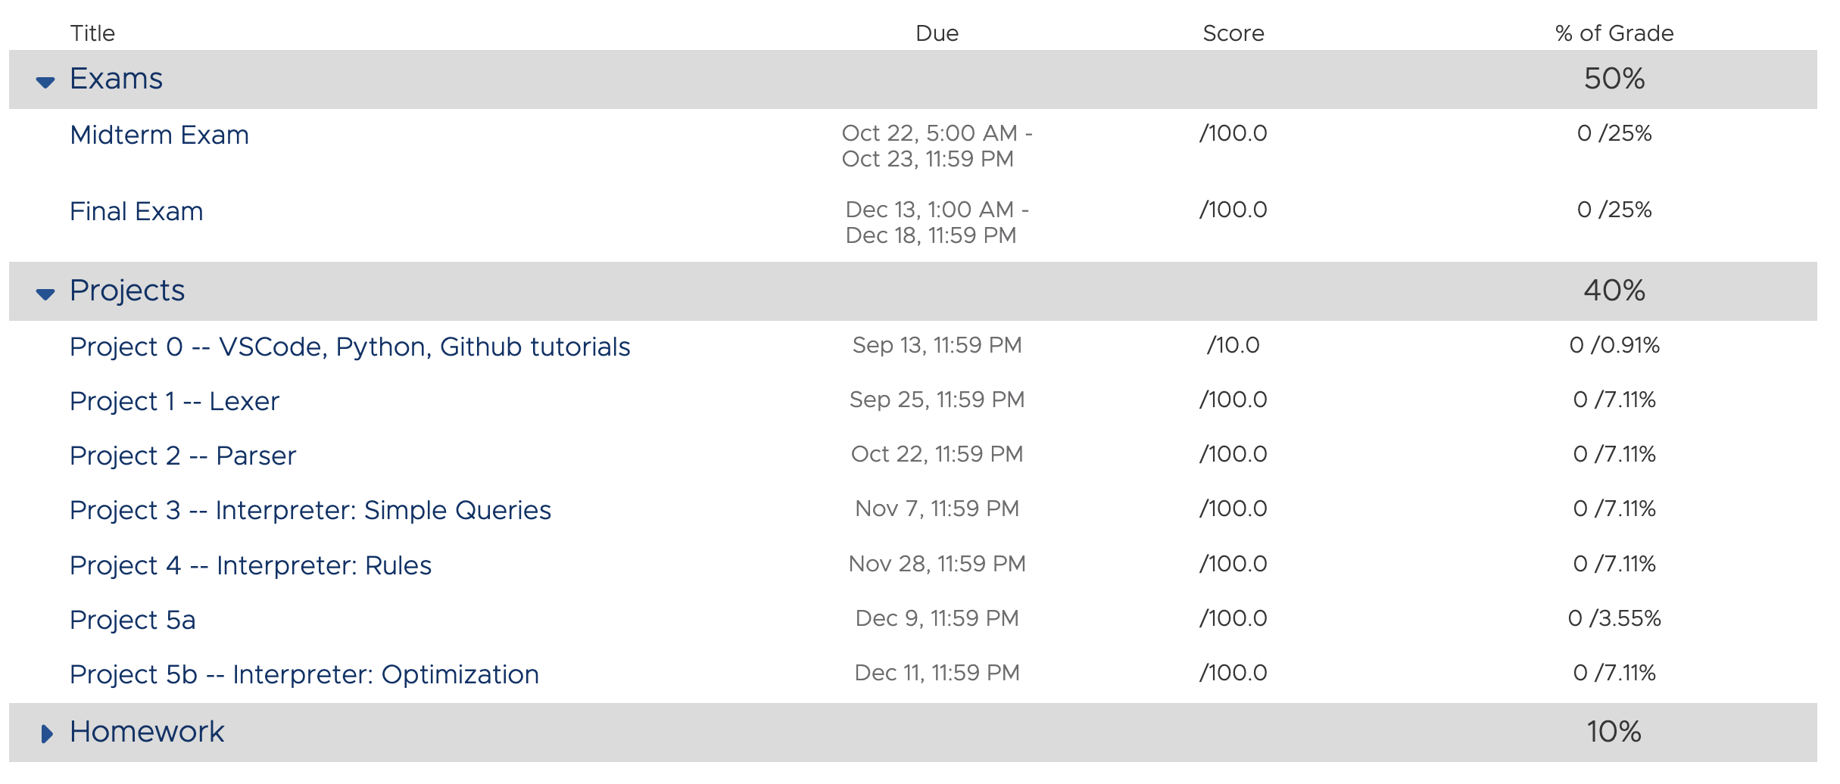
Course Assignments
5 Projects – all connected; the final project is one large system
~26 HWs – due on Monday, Wednesday, or Friday
1 Midterm
1 Final Exam – cumulative

Slide 9
Course Assignments
5 Projects – all connected; the final project is one large system
~26 HWs – due on Monday, Wednesday, or Friday
1 Midterm
1 Final Exam – cumulative

Slide 10
Course Assignments
5 Projects – all connected; the final project is one large system
~26 HWs – due on Monday, Wednesday, or Friday
1 Midterm
1 Final Exam – cumulative

Slide 11
Course Assignments
5 Projects – all connected; the final project is one large system
~26 HWs – due on Monday, Wednesday, or Friday
1 Midterm
1 Final Exam – cumulative

Slide 12
Course Assignments
5 Projects – all connected; the final project is one large system
~26 HWs – due on Monday, Wednesday, or Friday
1 Midterm
1 Final Exam – cumulative
Discussion
Learning activities vs
Assessment activities

Slide 13
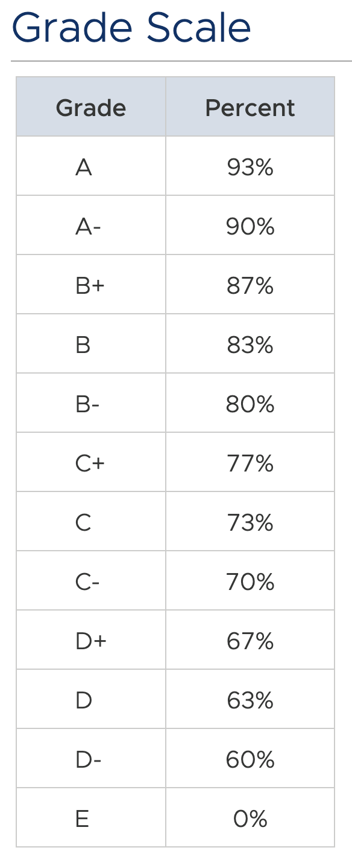
We reserve the right to lower the grade standard (e.g., from 93 to 92.5) if we mess something up during the semester
We will not raise the grade standard

Slide 14
Learning Suite: Things to Notice

Slide 15
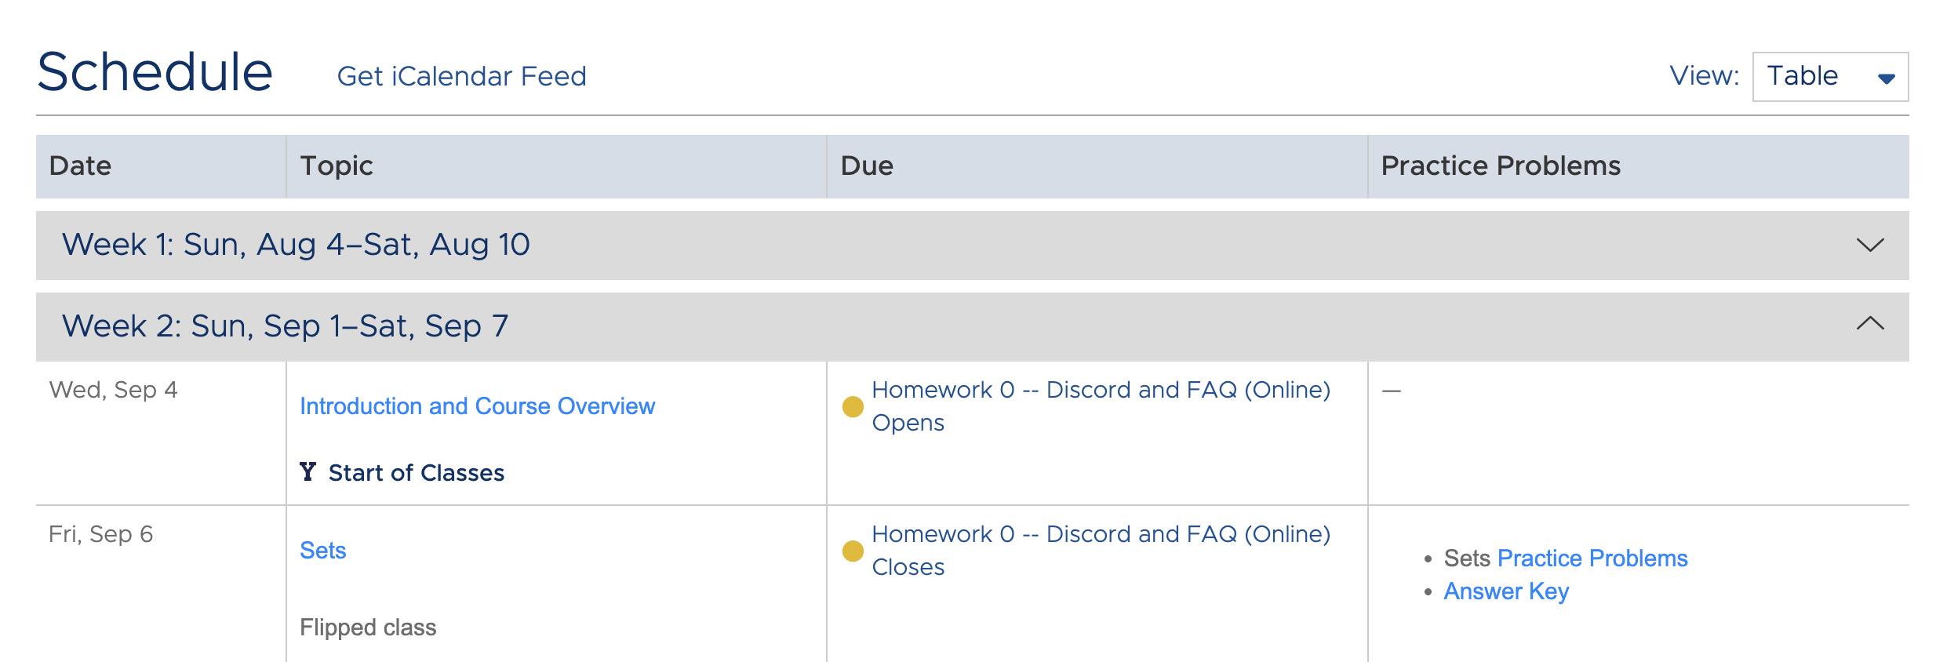
Many homework assignments are online

Slide 16
Many homework assignments are online
Learning Suite can only do these via their exam tool which makes the schedule look weird
Ignore this part of the schedule

Slide 17
Clicking on the lecture topic takes you to information about the lecture

Slide 18
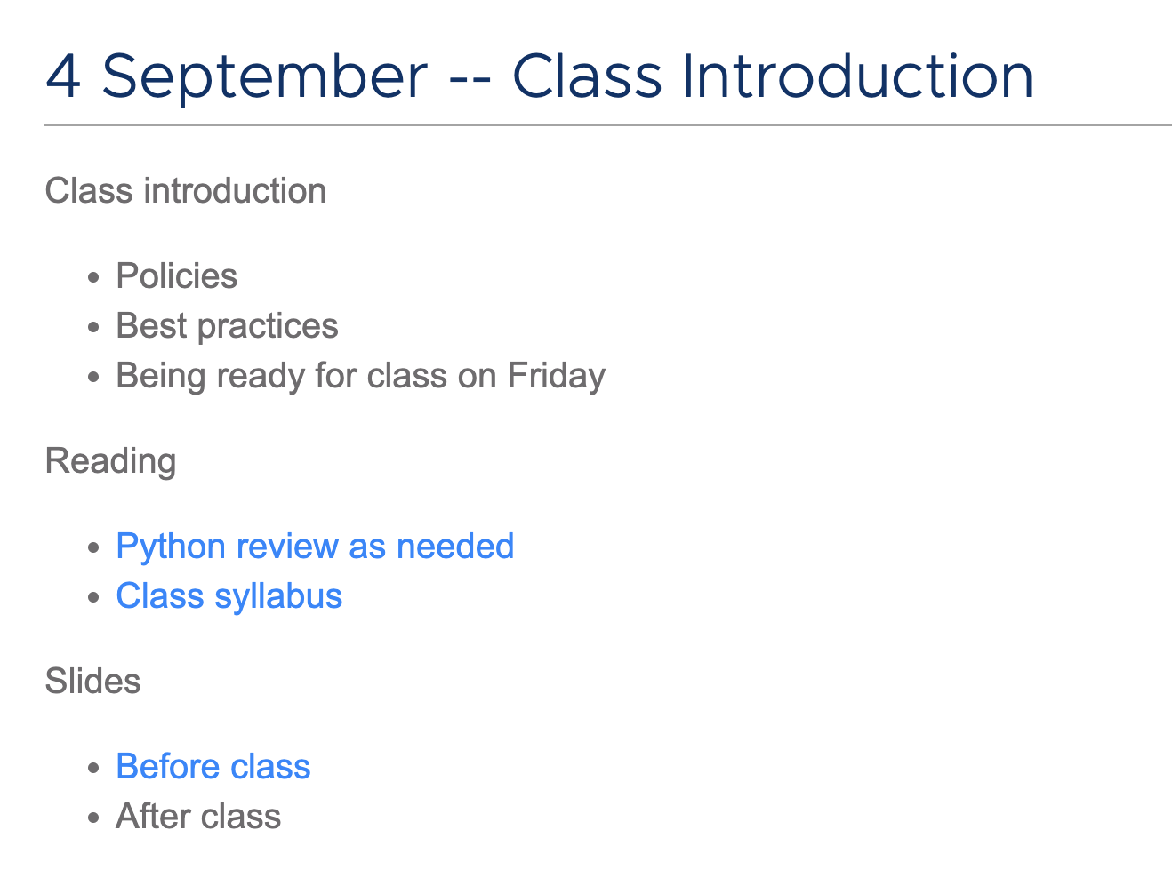
Assigned reading or viewing
Slides: before and after class

Slide 19
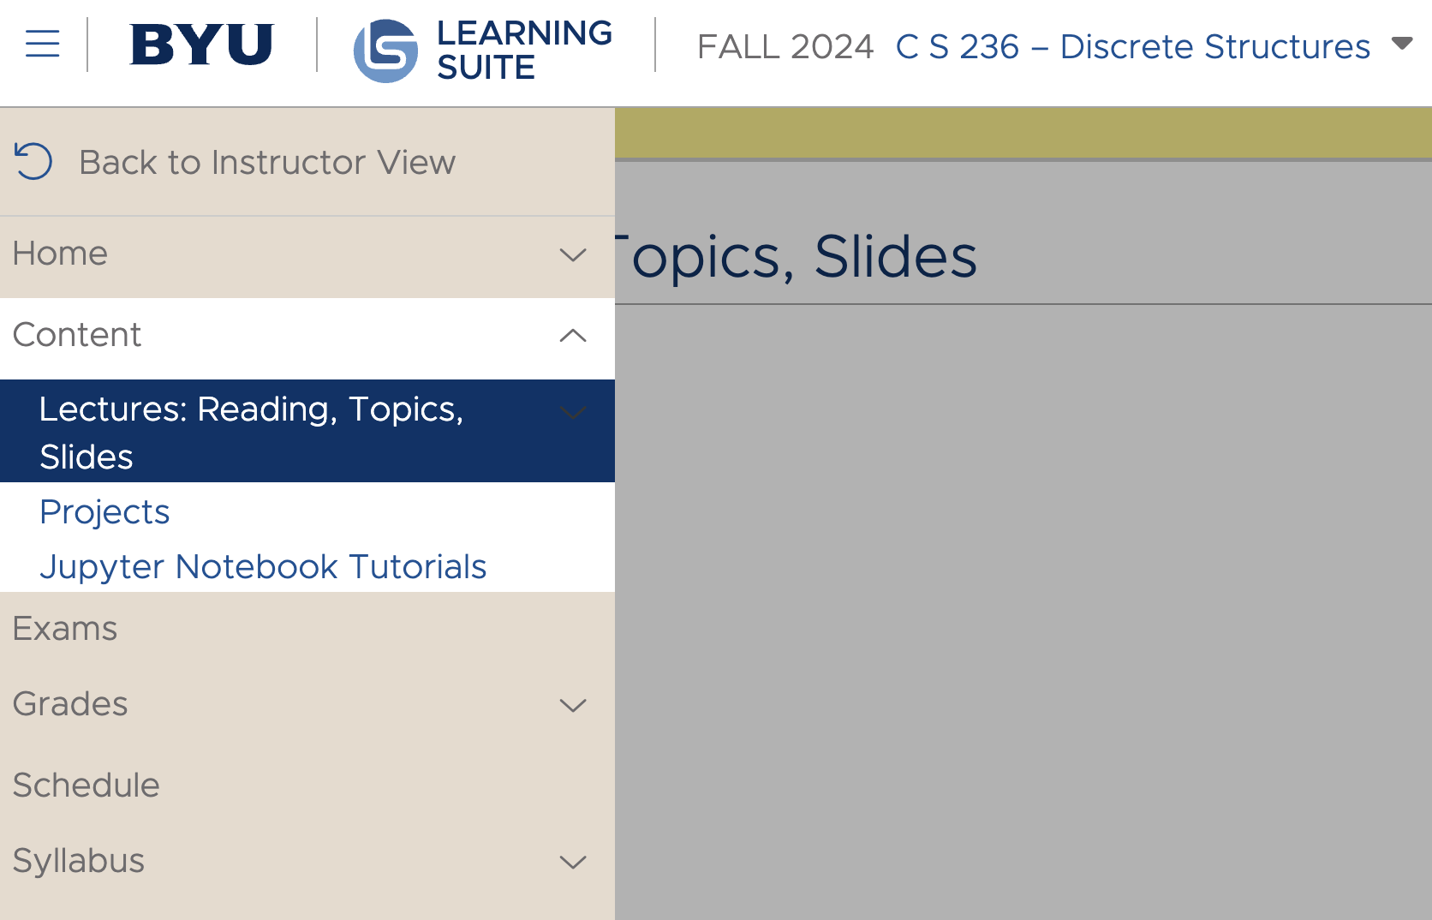
Can get to lectures directly via course content tab

Slide 20
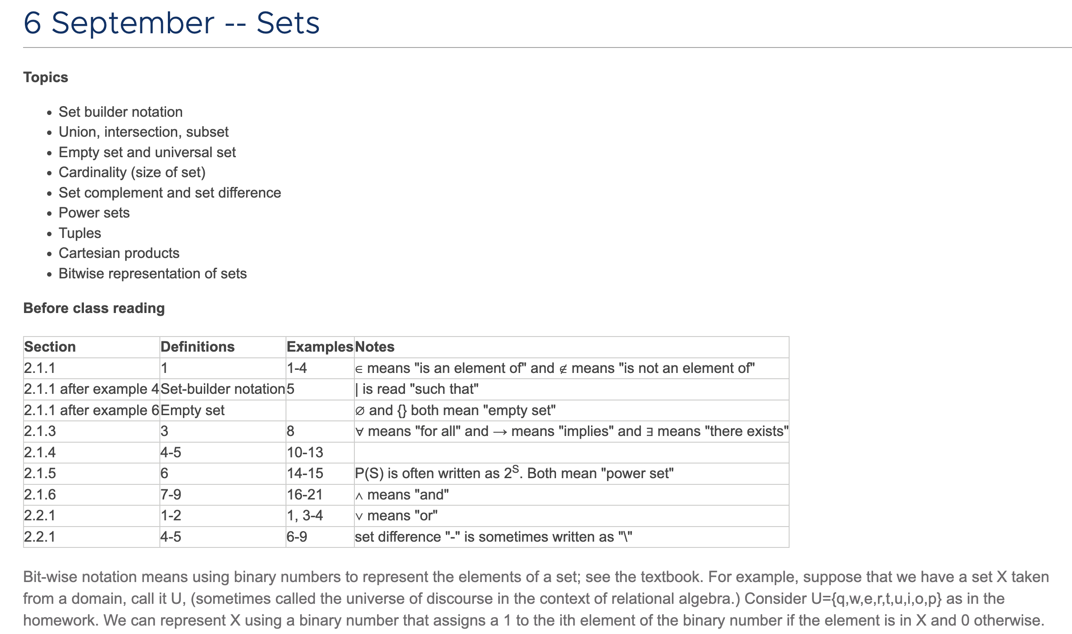
Friday’s lecture uses a ”flipped class” model.
Read before class
Work on HW in class with TA and instructor wandering around to help
Instructor will interrupt with discussions of tricky definitions (e.g., power set, Cartesian product)
Notes:
I try to use the lecture style that best matches the material rather than committing to all lectures or all flipped classes.

Slide 21
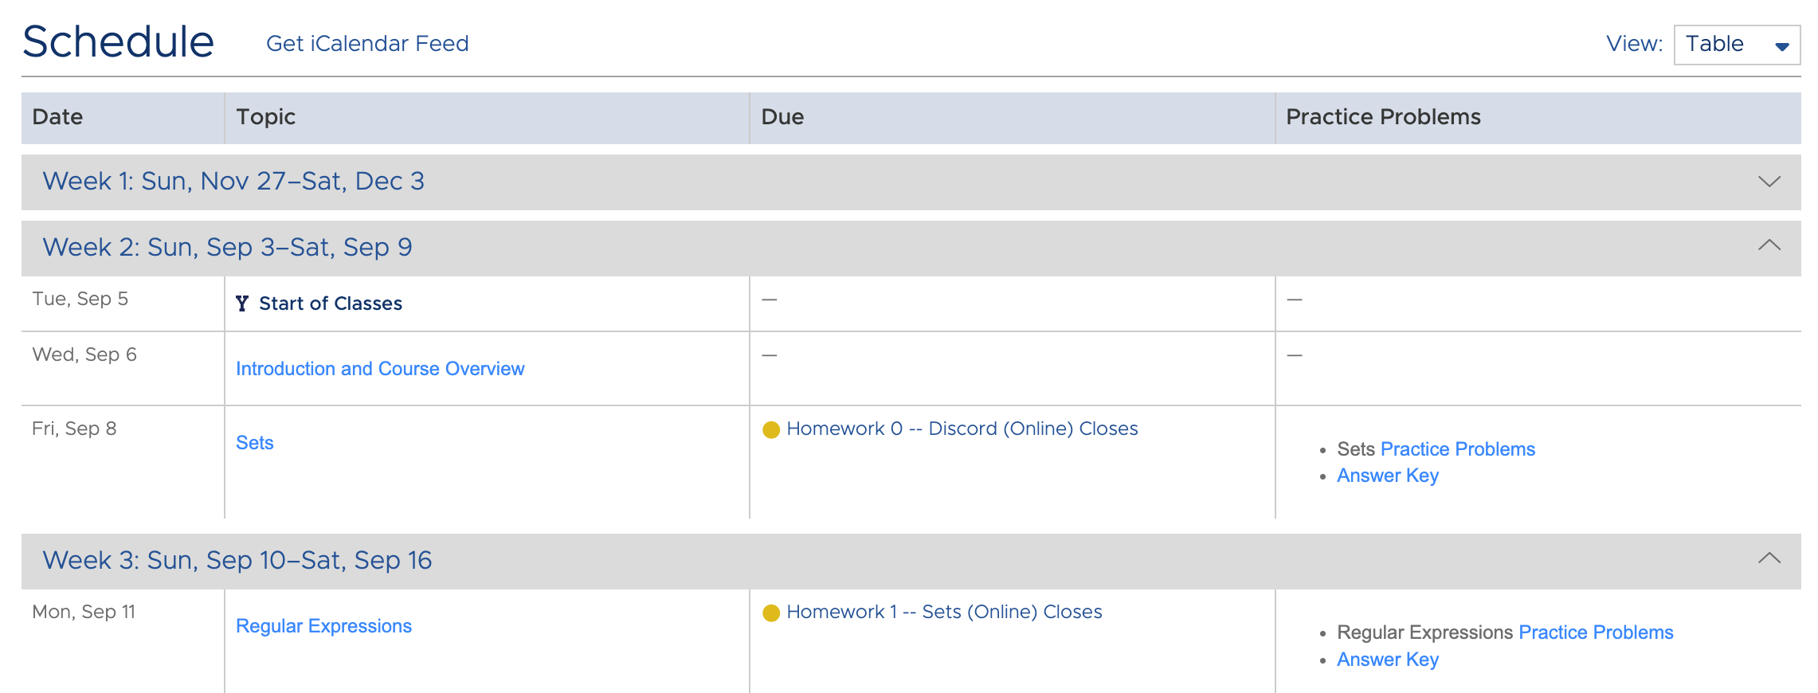
Clicking on what is due that day takes you to either
an online quiz or
a written assignment to be submitted by LS,

Slide 22
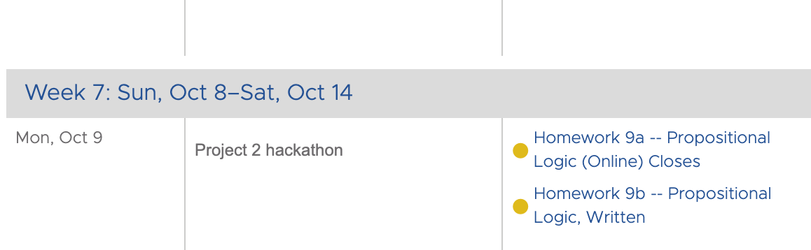
Clicking on what is due that day takes you to either
an online quiz or
a written assignment to be submitted by LS
and sometimes both

Slide 23
Online homework assignments can be taken twice
feedback is given on what you got right or wrong so you can learn
Many online homework assignments require you to solve problems, so plan on having paper available
Homework is only worth 10% of your grade
learning versus assessment activities
don’t have to retake second time

Slide 24
We prefer to not accept late homework since it’s such a small part of your grade
But we will consider it if you ask and have a reason

Slide 25
Practice problems and solutions are posted
these are not maintained but might be helpful

Slide 26
Projects

Slide 27
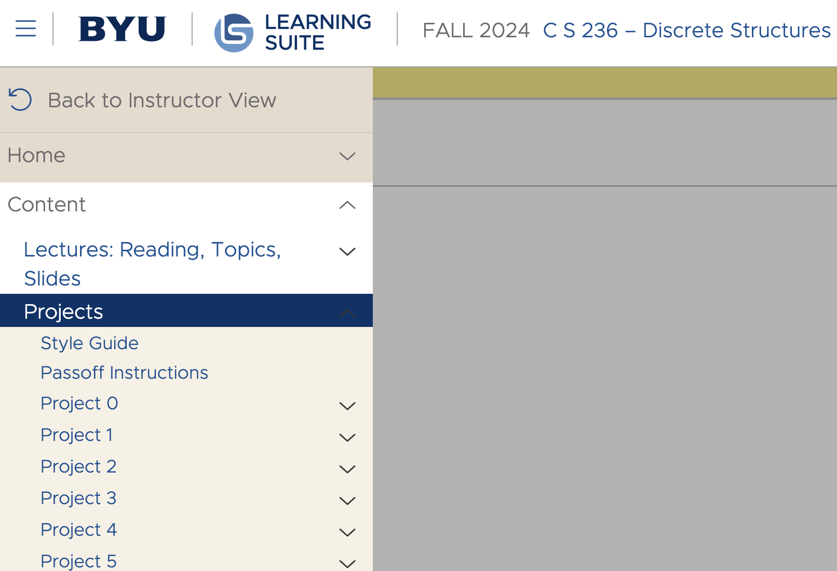
Access through schedule or directly through Content tab

Slide 28
Use the Python style guide. Type annotations required.

Slide 29
Semester-Long Project: Create a Datalog Interpreter
your Datalog program
Lexer
Parser
Execution
tokens
“meaning”
Mapping of Interpreter to Projects
Mapping of Schemas to Projects
Lexer: Project 1
Schema 1: Recognizers & Generators - Projects 1 & 2
Parser: Project 2
Schema 2: Logic & Relations - Projects 3 & 4
Execution: Projects 3, 4, & 5
Schema 3: Graphs & Algorithms - Project 5

Slide 30
Semester-Long Project: Create a Datalog Interpreter
your Datalog program
Lexer
Parser
Execution
tokens
“meaning”
Project 1 must work before project 2 will work
and so on
Do your best to start early
Mapping of Interpreter to Projects
Mapping of Schemas to Projects
Lexer: Project 1
Schema 1: Recognizers & Generators - Projects 1 & 2
Parser: Project 2
Schema 2: Logic & Relations - Projects 3 & 4
Execution: Projects 3, 4, & 5
Schema 3: Graphs & Algorithms - Project 5

Slide 31
Project 0
Install and configure IDE
You can use whatever IDE you like …
… but TAs can only help you with vscode issues
“Installfest” tonight and tomorrow from 7-8:30 outside the TA offices

Slide 32
Project 0
Learn how to use virtual environments
Virtual environments make is to that everyone is effectually using the exact same set-up

Slide 33
Project 0
Set up github Classroom
Learn how to clone starter code
Starter code is intended to help you structure your code in such a way that it aligns with subsequent projects

Slide 34
Project 0
Learn how to passoff locally and on github
We give you all test cases that you can passoff on your machine
When you commit your project to github, you can also make sure that your code passes off there
Run tests locally before trying on github

Slide 35
Project 0
Learn how to submit code to TAs for grading
Submit url for a pull request on Learning Suite
TAs will look at your code to see if you used the correct math structures

Slide 36
Project 0 “Installfest”
Installfest in basement of TMCB tonight and tomorrow (Sept 4 and 5) from 7:00pm-8:30pm
Go through first several steps of Project 0 as a group with TA support

Slide 37
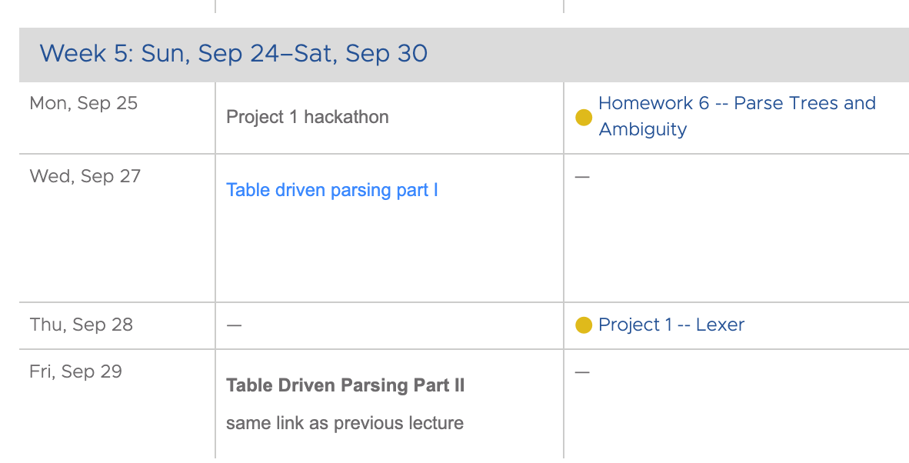
We’ll try to set it up so that no homework is due the day before or the day after a project is due
Hopefully, this will help a bit with workload balancing
but it won’t always be possible (sorry)

Slide 38
Project Late and Early Days
1 point extra credit for each day early
but only up to 3 total points
2 points off for each day late
Projects completed more than two weeks after due date can only be graded if you coordinate with me

Slide 39
Exams

Slide 40
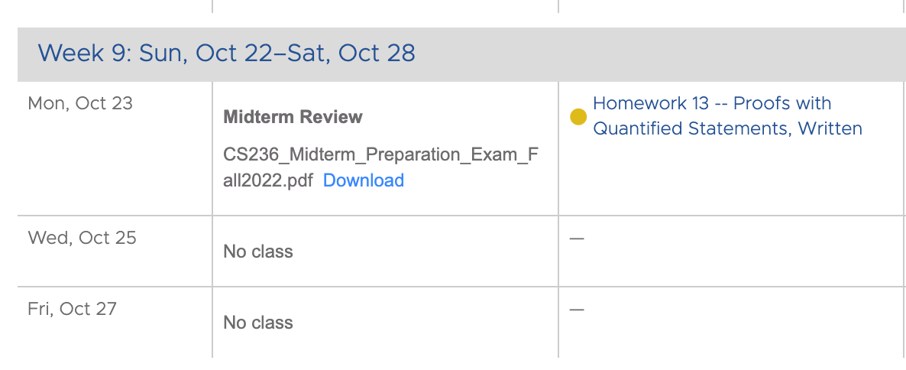
Two parts of exam
Preparation exam
Actual exam

Slide 41
Actual exam will be online via LS
Timed
Closed book except for one sheet of notes
Unproctored
Not Chat-GPT proof

Slide 42
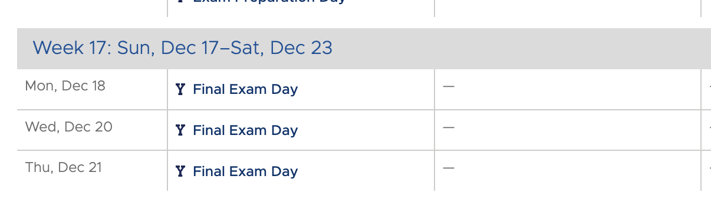
The final exam is online, not at a specific day and time
Take it when you like and where you like

Slide 43
Exam Pedagogy – why so weird?
Topics in reading
Topics discussed in class
Topics on homework /projects
Topics on preparation exam
Topics on actual exam

Slide 44
Course Resources

Slide 45
Course Resources
Exceptions

Slide 46
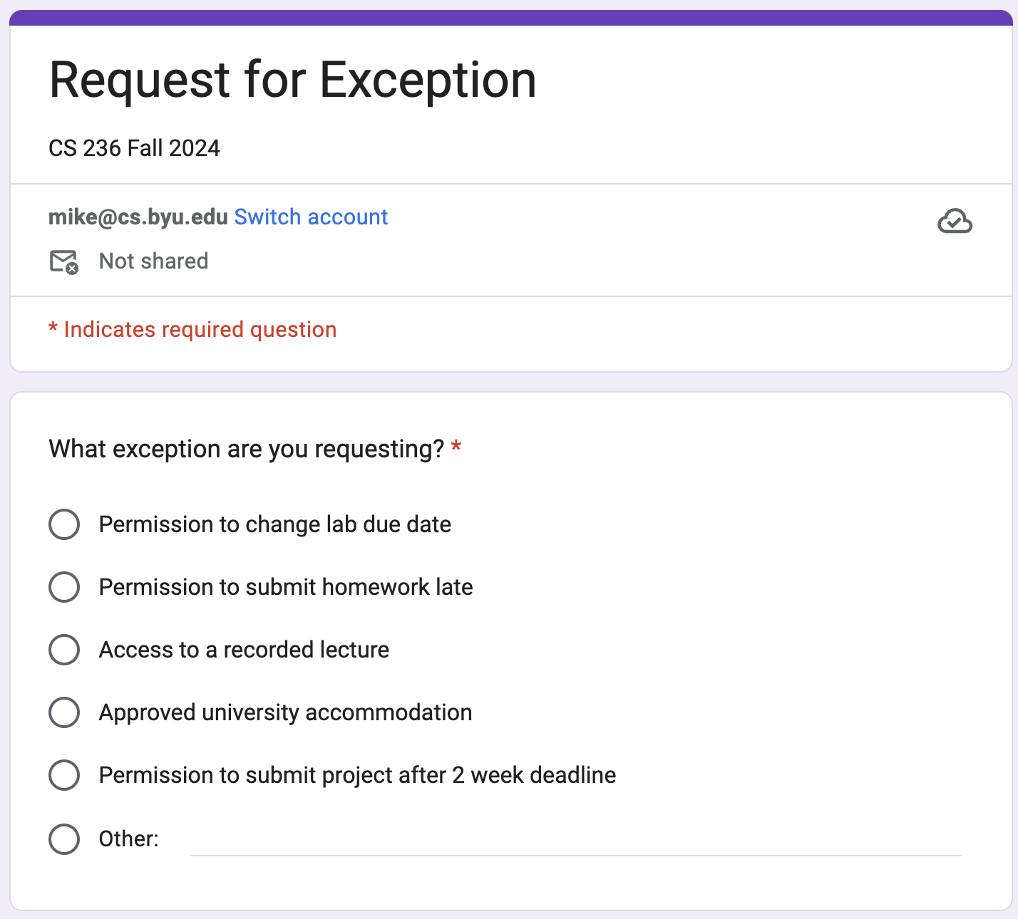
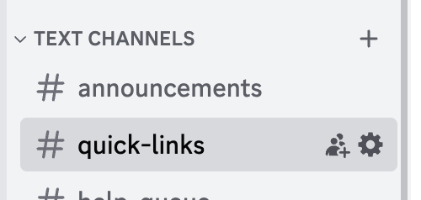
Please submit request for exception to late policy using the form
Pinned to Discord #quick-links
Under LS Announcements tab

Slide 47
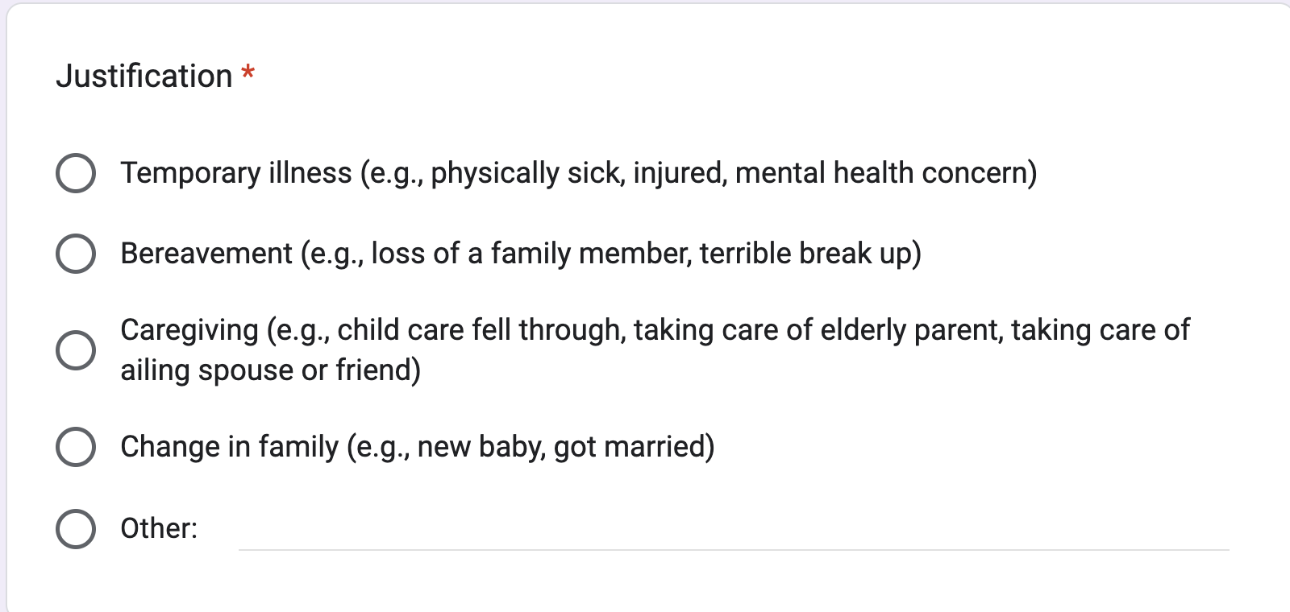
No difference between physical and mental health setbacks
I’m pretty generous, but please don’t take advantage of me

Slide 48
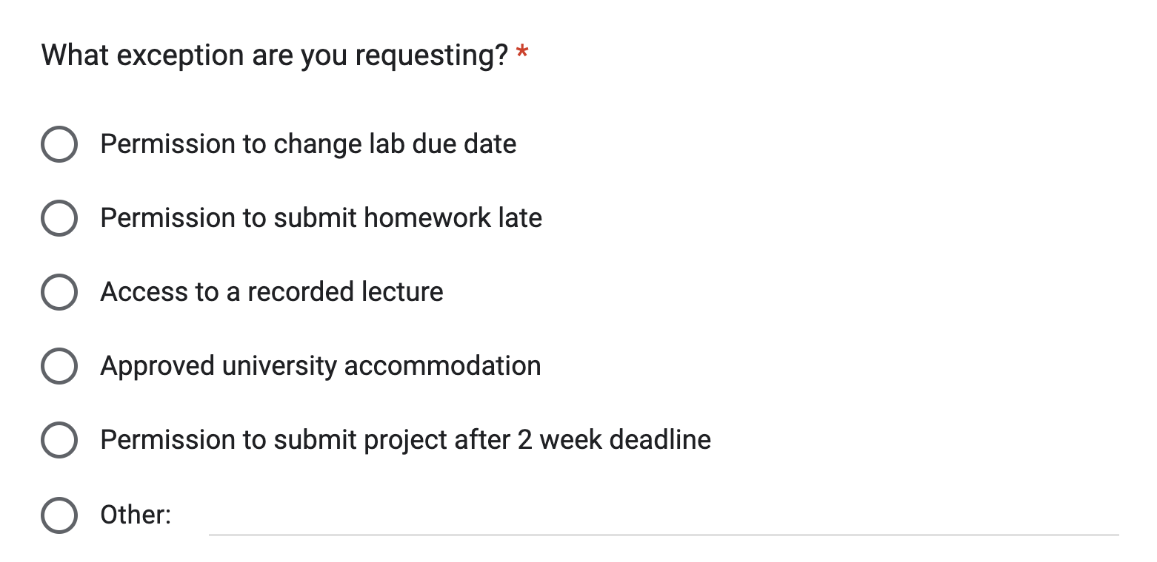
I prefer to not make exceptions for late homeworks
They are worth so few points in your total grade

Slide 49
University Accommodations
Instructors are sincerely committed to working with students who need accommodations
Please work with the University Accessibility Center
And please let your instructor know when we need to apply the accommodation

Slide 50
Course Resources
Exceptions
Discord

Slide 51
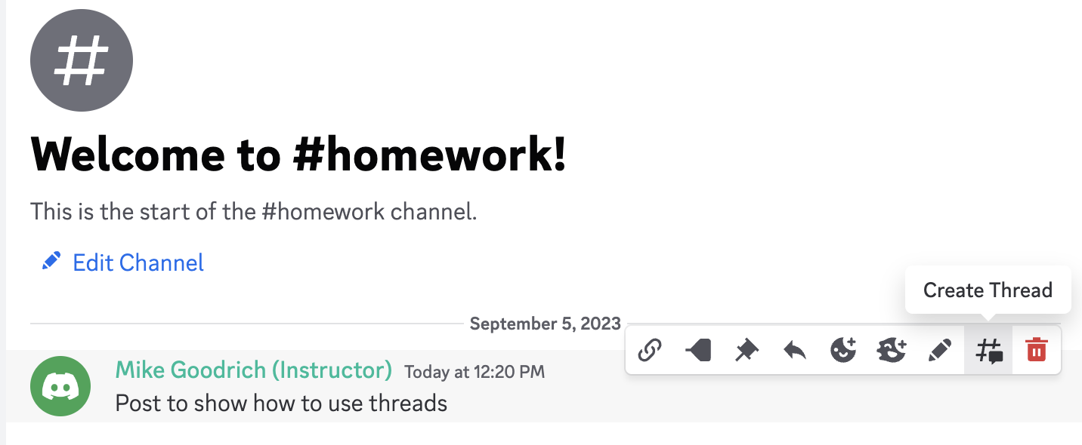
Class Discord channel
Use informative first line of message

Slide 52
Class Discord channel
Hover over first line to pull up options

Slide 53
Class Discord channel
Create a thread response if one doesn’t exist

Slide 54
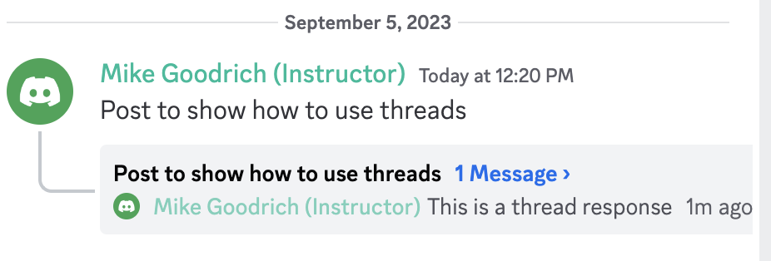
Class Discord channel
View other messages in thread

Slide 55
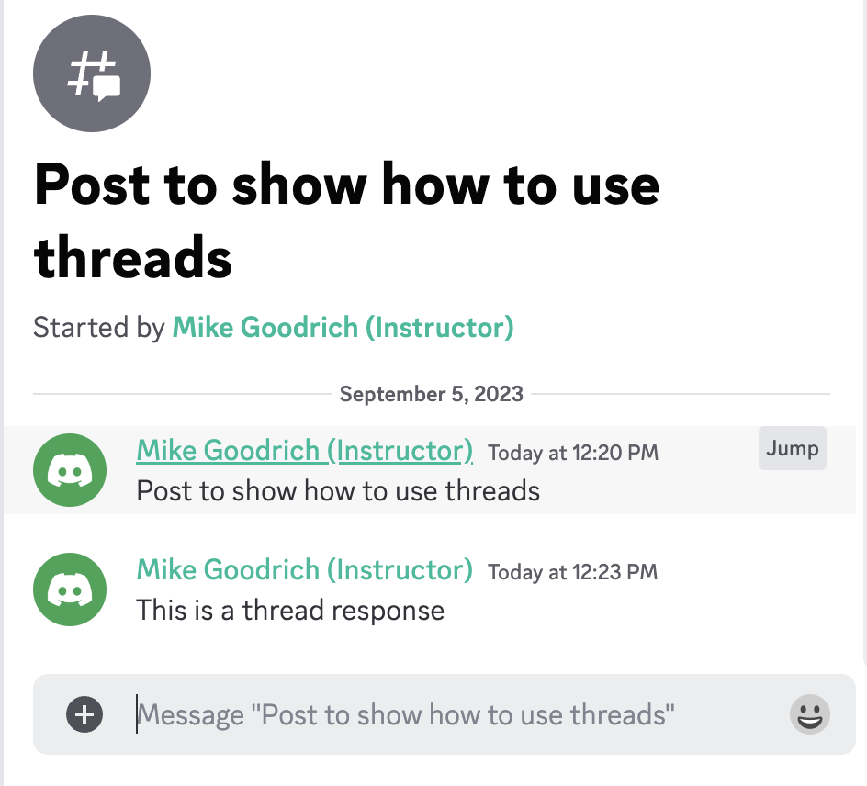
Add responses or follow up questions to the thread

Slide 56
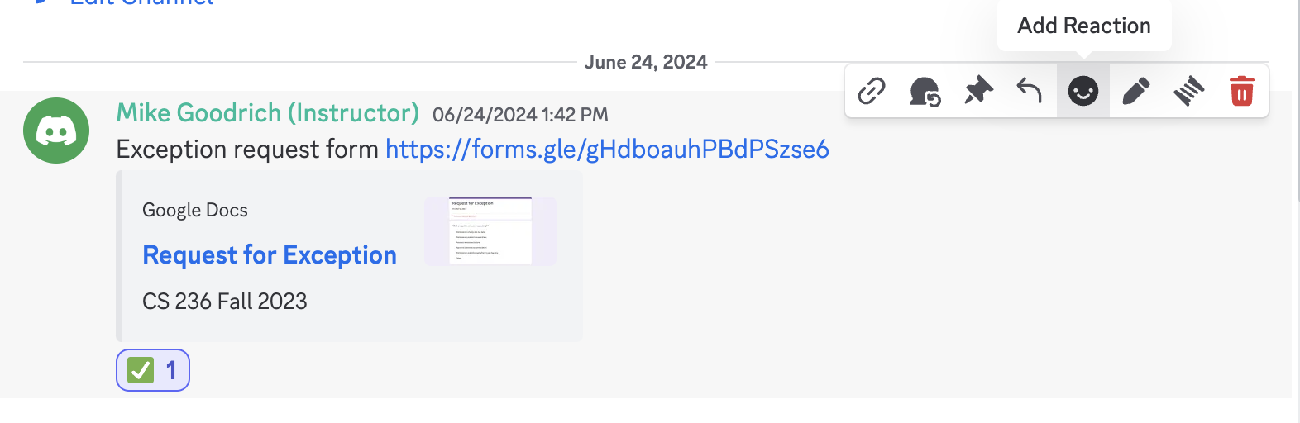
Class Discord channel
Goodrich will analyze Discord use patterns to improve future classes
To help, please add a reaction to posts you read whenever feasible

Slide 57
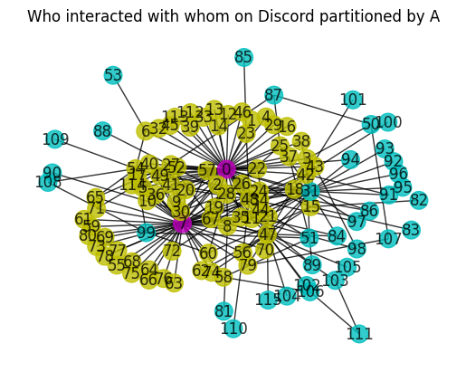
Class Discord channel
Goodrich will analyze Discord use patterns to improve future classes
To help, please add a reaction to posts you read whenever feasible

Slide 58
Class Discord channel
Hover over face emoji
Select checkbox
Goodrich will analyze Discord use patterns to improve future classes
To help, please add a checkbox to posts you read even if you don’t respond

Slide 59
Class Discord channel
Goodrich will analyze Discord use patterns to improve future classes
If you’ve used an LLM to try and understand a question or to generate a response, please tag with #LLM at the message end

Slide 60
Class Discord channel
Goodrich will analyze Discord use patterns to improve future classes
If you’ve used an LLM to try and understand a question or to generate a response, please tag with #LLM at the message end
I want to know how LLM agents contribute to learning

Slide 61
Course Resources
Exceptions
Discord
Instructors

Slide 62
Instructor 1: Mike Goodrich
mike@cs.byu.edu from BYU email addresses only
Discord DM – @Mike Goodrich (Instructor)
LS messages -- expect delays
Office hours
M at noon
W at 3pm
others by appointment

Slide 63
Instructor 2: Eric Mercer
egm@cs.byu.edu from BYU email addresses only
Discord DM -- @egm
LS messages -- expect delays
Office hours:
MWF 11am
Feel free to stop by. If available, happy to help

Slide 64
Course Resources
Exceptions
Discord
Instructors
TAs

Slide 65
TAs
Regular TA office hours
No Friday night
Via discord voice channel and in person

Slide 66
TAs
We try hard to not have the TAs grade very much
This allows them to be more proactive

Slide 67
TAs
TAs will hold project help sections

Slide 68
Course Resources
Exceptions
Discord
Instructors
TAs
CS Belonging Office

Slide 69

CS Belonging Office
Really good group of student mentors
https://csdiversity.byu.edu/

Slide 70
Course Resources
Exceptions
Discord
Instructors
TAs
CS Belonging Office
Textbook

Slide 71
Textbook
Good book
Way too expensive
After the semester, use Wikipedia, YouTube, ChatGPT, or online tutorials
We suggest renting the textbook or buying the pdf
Can you use
the 7th edition?
the international edition?

Slide 72
Course Resources
Exceptions
Discord
Instructors
TAs
CS Belonging Office
Textbook
Zoom live access and zoom recordings

Slide 73
Blended Class Structure
We’ll stream every lecture on zoom
In case you can’t make it to class
A TA will monitor the chat and help answer questions
But we strongly encourage in class attendance
We’ll try to remember to record each lecture
Please request a link to the recording if you need it
We might forget … BYU no longer allows us to automatically record zoom meetings

Slide 74
Blended Class Structure
We’ll stream every lecture on zoom
In case you can’t make it to class
A TA will monitor the chat and help answer questions
But we strongly encourage in class attendance
We’ll try to remember to record each lecture
Please request a link to the recording if you need it
We might forget … BYU no longer allows us to automatically record zoom meetings
Linked pinned to Discord #quick-links channel

Slide 75
Make your life better
Best practices for succeeding in class

Slide 76
make your life Better – Part 1
Test-Driven or Iterative Development
Essence: write unit tests before coding small parts of the system
Pros: prevents the 20-hour, weekend-killing “bugs”; results in better code organization; results in faster overall development
Cons: you’ve probably never done it before and bad habits are hard to break; you’ll also probably think/feel you’re going slower – the truth is, debugging is always slower than testing

Slide 77
make your life Better – Part 2
Community of practice
Look at each others code
Help each other debug
Design together
Follow the discord discussions for each project
But don’t copy each other’s code

Slide 78
make your life Better – Part 3
Do the math part of the projects before writing code
Design your tests around the math part
Project 1 is way easier if you design the state machines first!
5 hours of programming can save you 30 minutes with pencil and paper

Slide 79
make your life Better – Part 4
Make sure your code passes all Test Cases
We give you every test case used in passoffs by the TAs
Don’t share these … other semesters of CS 236 do not have access to the tests

Slide 80
make your life Better – Part 5
Read and watch before class whenever feasible
We’ll let you know when we’ll assume you won’t have read before class
We recognize that you won’t always succeed at pre-class prep, but please do your best

Slide 81
make your life Better – Part 6
When to use Chat GPT and Copilot
Interpret compiler errors
Understand example code
Generate support code
opening and accessing files
using exception handling
Give examples or explanations of math

Slide 82
make your life Better – Part 7
How to use Chat GPT and Copilot
Ask it to respond as if it were a class tutor
Ask it to show you alternate ways of solving a problem
Ask follow up questions
Ask for clarifications
Ask for incorrect ways of solving a problem and why they are wrong
Try to remember that your job is to learn so focus queries on learning
Try not to get too hung up on just getting the assignment finished

Slide 83
make your life Better – Part 8
When not to use Chat GPT
Don’t use it to generate your code
Don’t use it exclusively – also use stackoverflow, geeks for geeks
Don’t have it solve your homework problems
Don’t use it on exams

